Slide 1

1
USABILITY TESTING AND VERIFICATION
Wanderlust Travel
Submitted By:
Swaraj Rath
Vikas Dodera Thimmiaha

Slide 2
2
INTRODUCTION
MOTIVATION
USE CASES
DESIGN PROCESS
DEMO
USABILITY TESTING
CONCLUSION
CONTENTS

Slide 3










3
INTRODUCTION
IDEA
Use of existing tourism website
Travel App with personalized plans
DISAPPOIANTED USERS
It’s time to travel the world
EXISTING TRAVEL WEBS
JOURNEY BEGINING
User Satisfaction is marginal
PROBLEM
Only existing plans are available

Slide 4
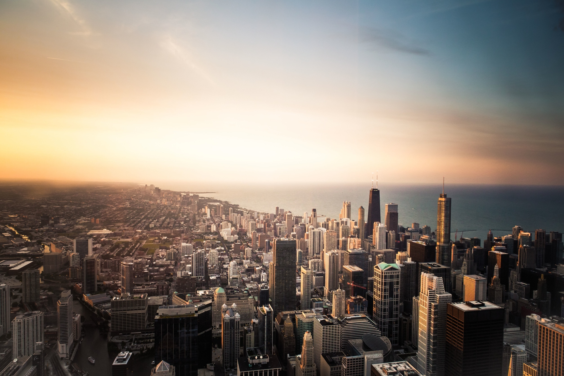
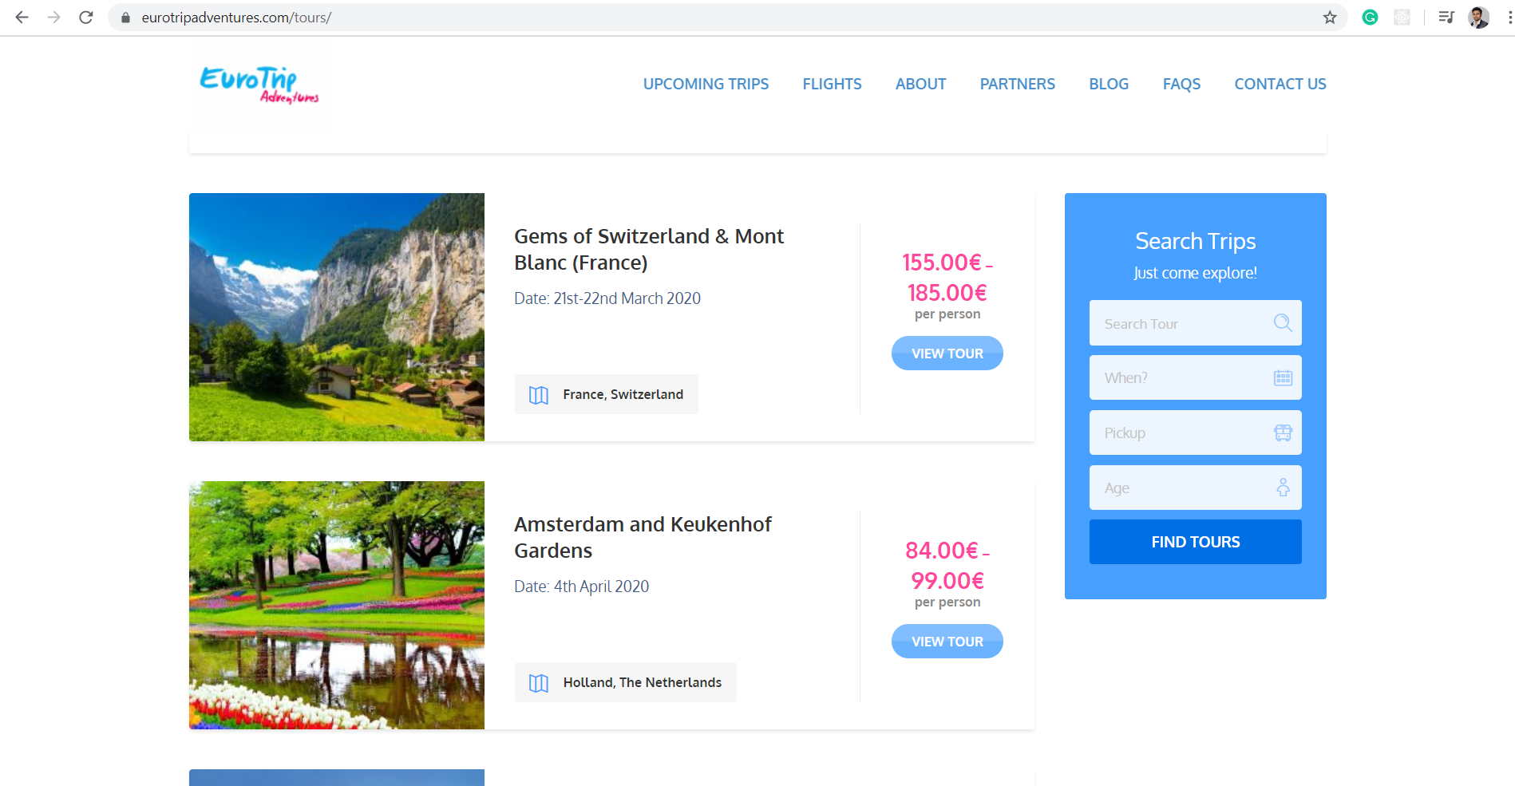
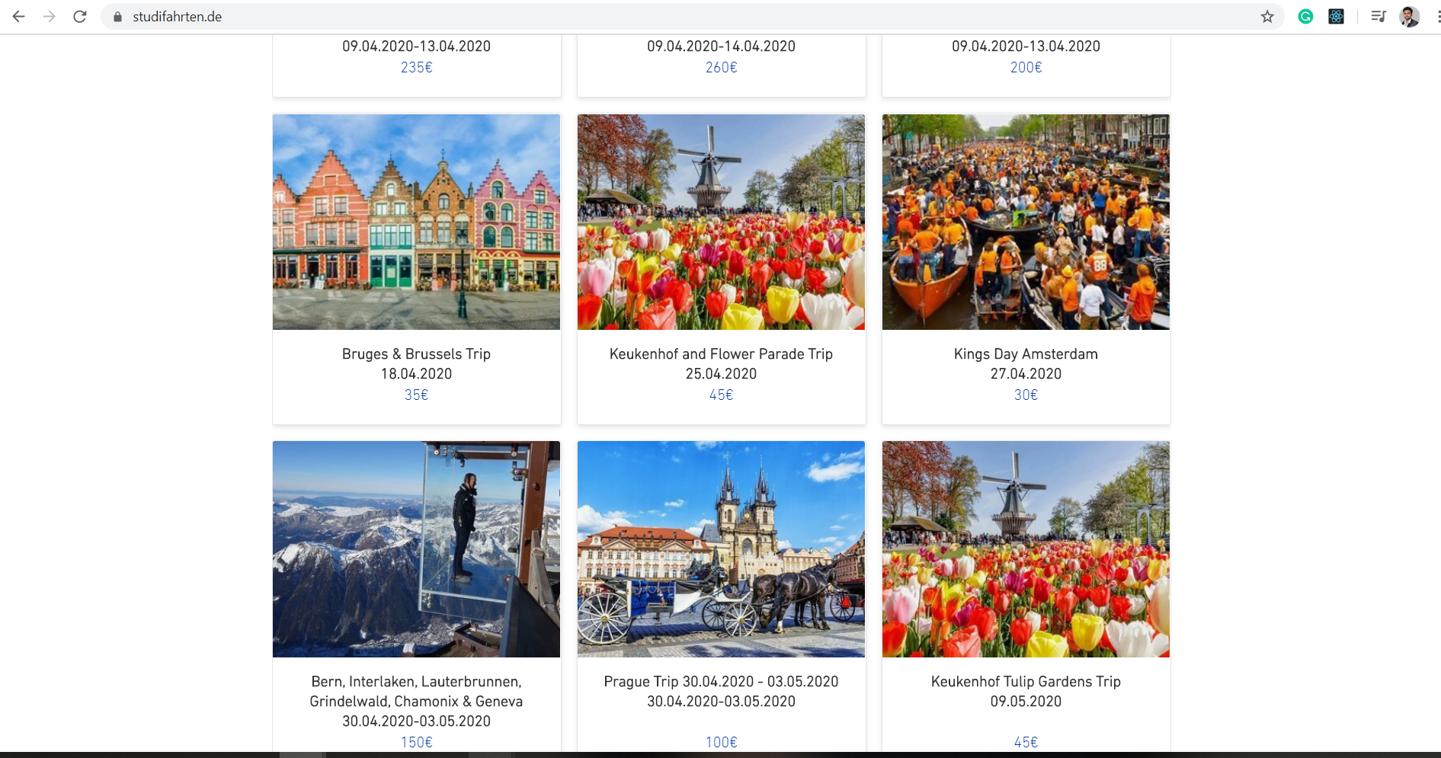
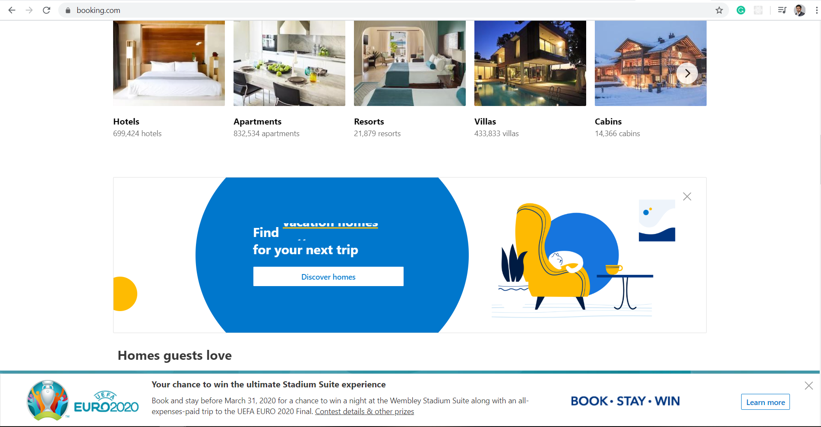
4
COMPETITOR WEBSITES
1
2
3
4
Only Existing Deals Available
Dates are not Feasible
Full of Unwanted Ads
Lack of Transparent information
The existing tourism companies only provides deals to the same places
The travel date are fixed in the packages which creates several restrictions
The websites are now a days very full of unwanted ads which causes irritation.
In the tour packages they hide the fact that what are the things included and excluded in the trip

Slide 5

5
Paper Prototype
DESIGN PROCESS
Mock-up
Final Prototype

Slide 6
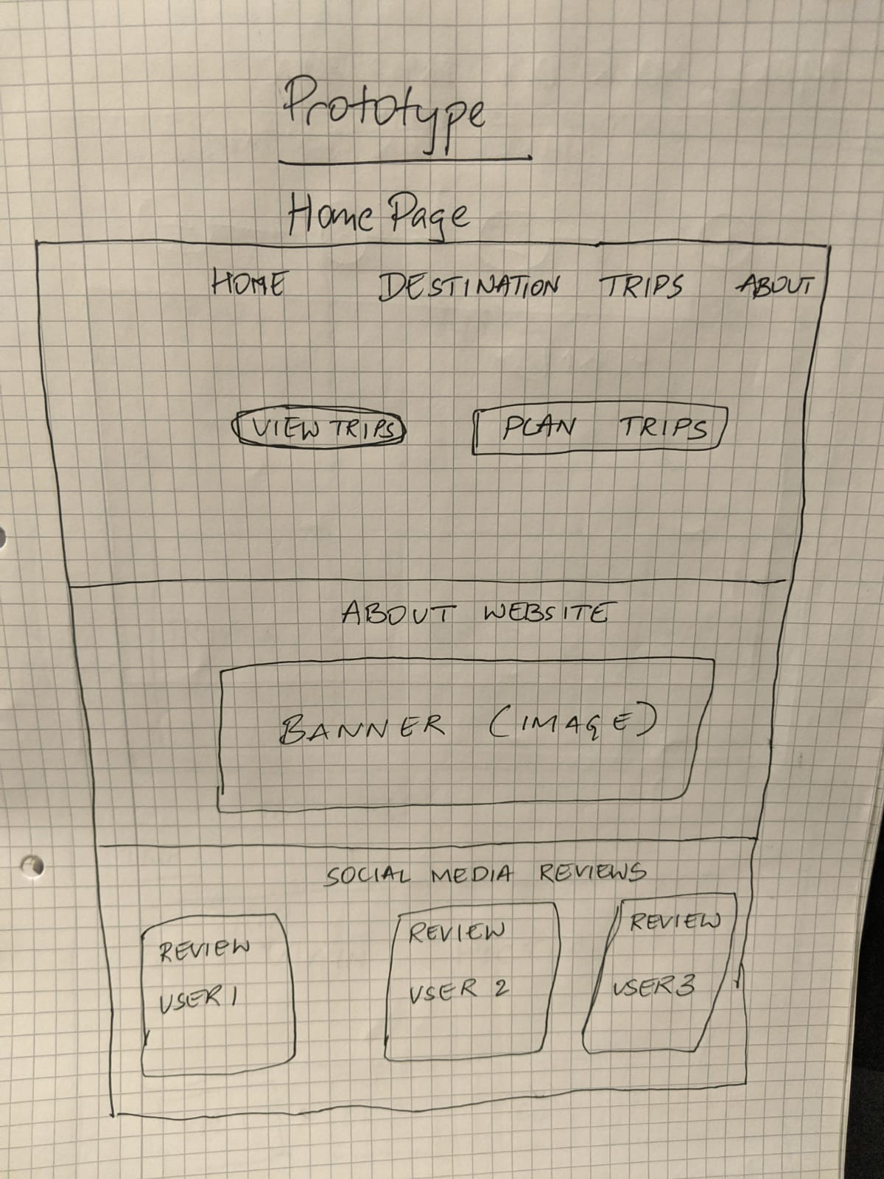
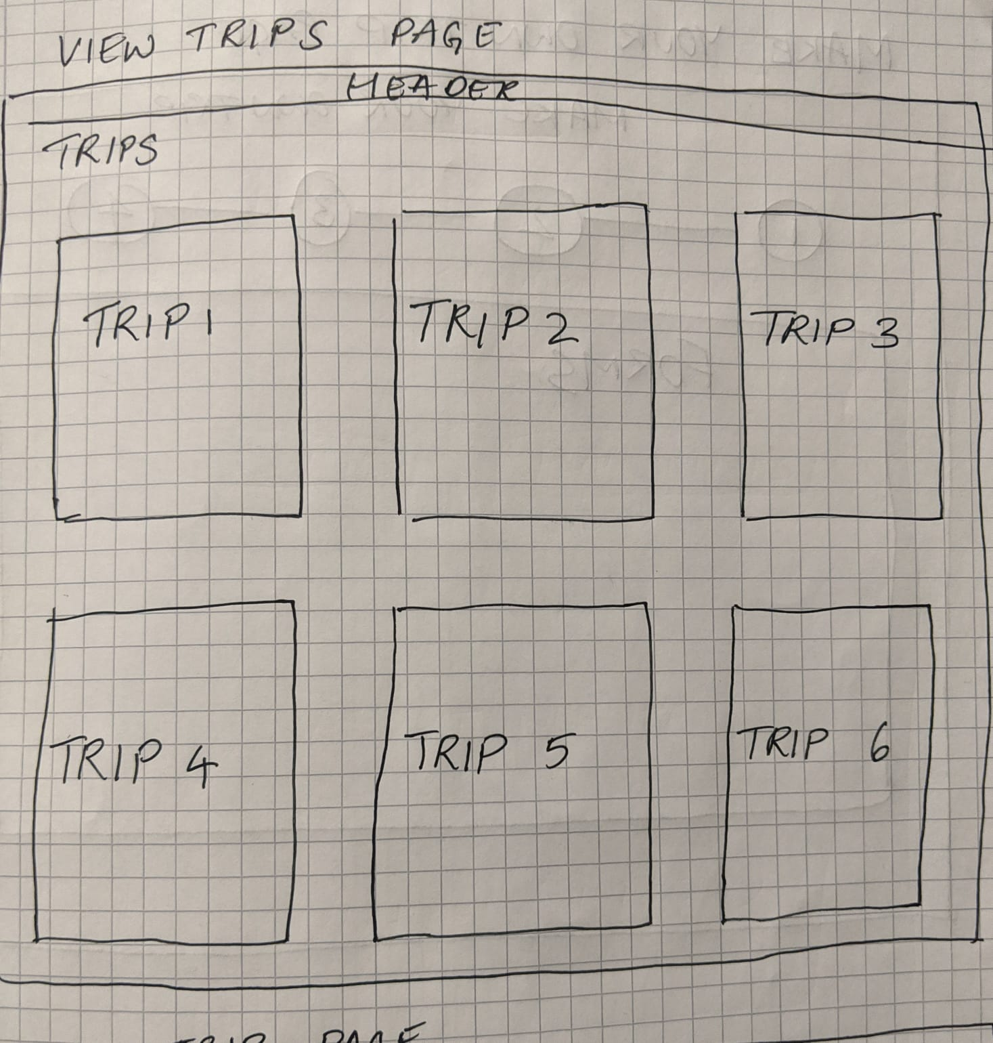
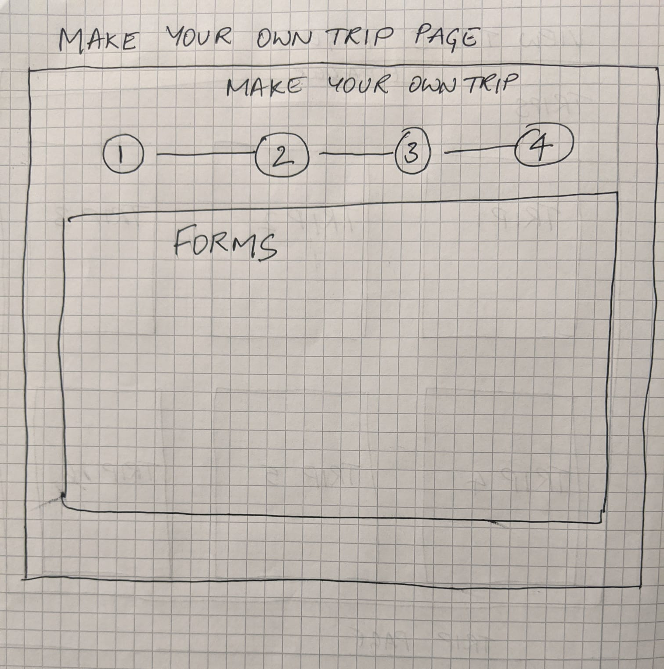
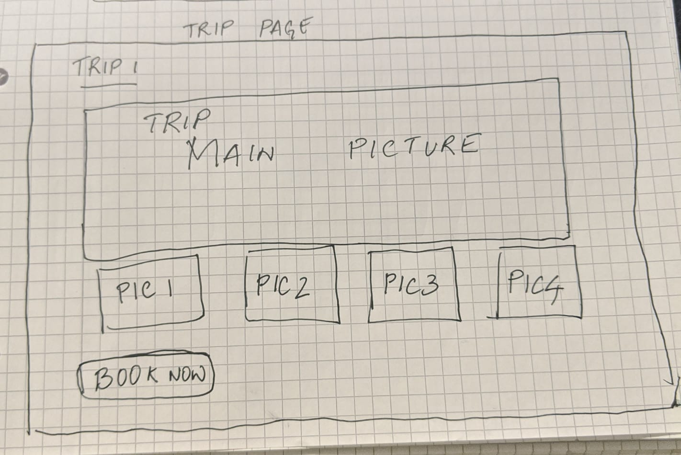
6
Paper Prototype

Slide 7
USABILITY
TESTING

Slide 8
7
Red Route
TIME
ALWAYS |  | Choose Activities | Manage trip expenses. | Make your own trip package.
MOSTLY |  |  | Read Reviews | Brief review of places.
FEW |  |  |  | Choose pre planned trips
VERY LESS
USERS | VERY LESS | FEW | MOST | ALL
Survey Monkey link: https://www.surveymonkey.com/summary/aOKTOXQFN_2FBlckodhZ1FivfrlmbX15wZ5aJJz8t3JGLoFR69jeEauzZ2FLIEpNOh

Slide 9
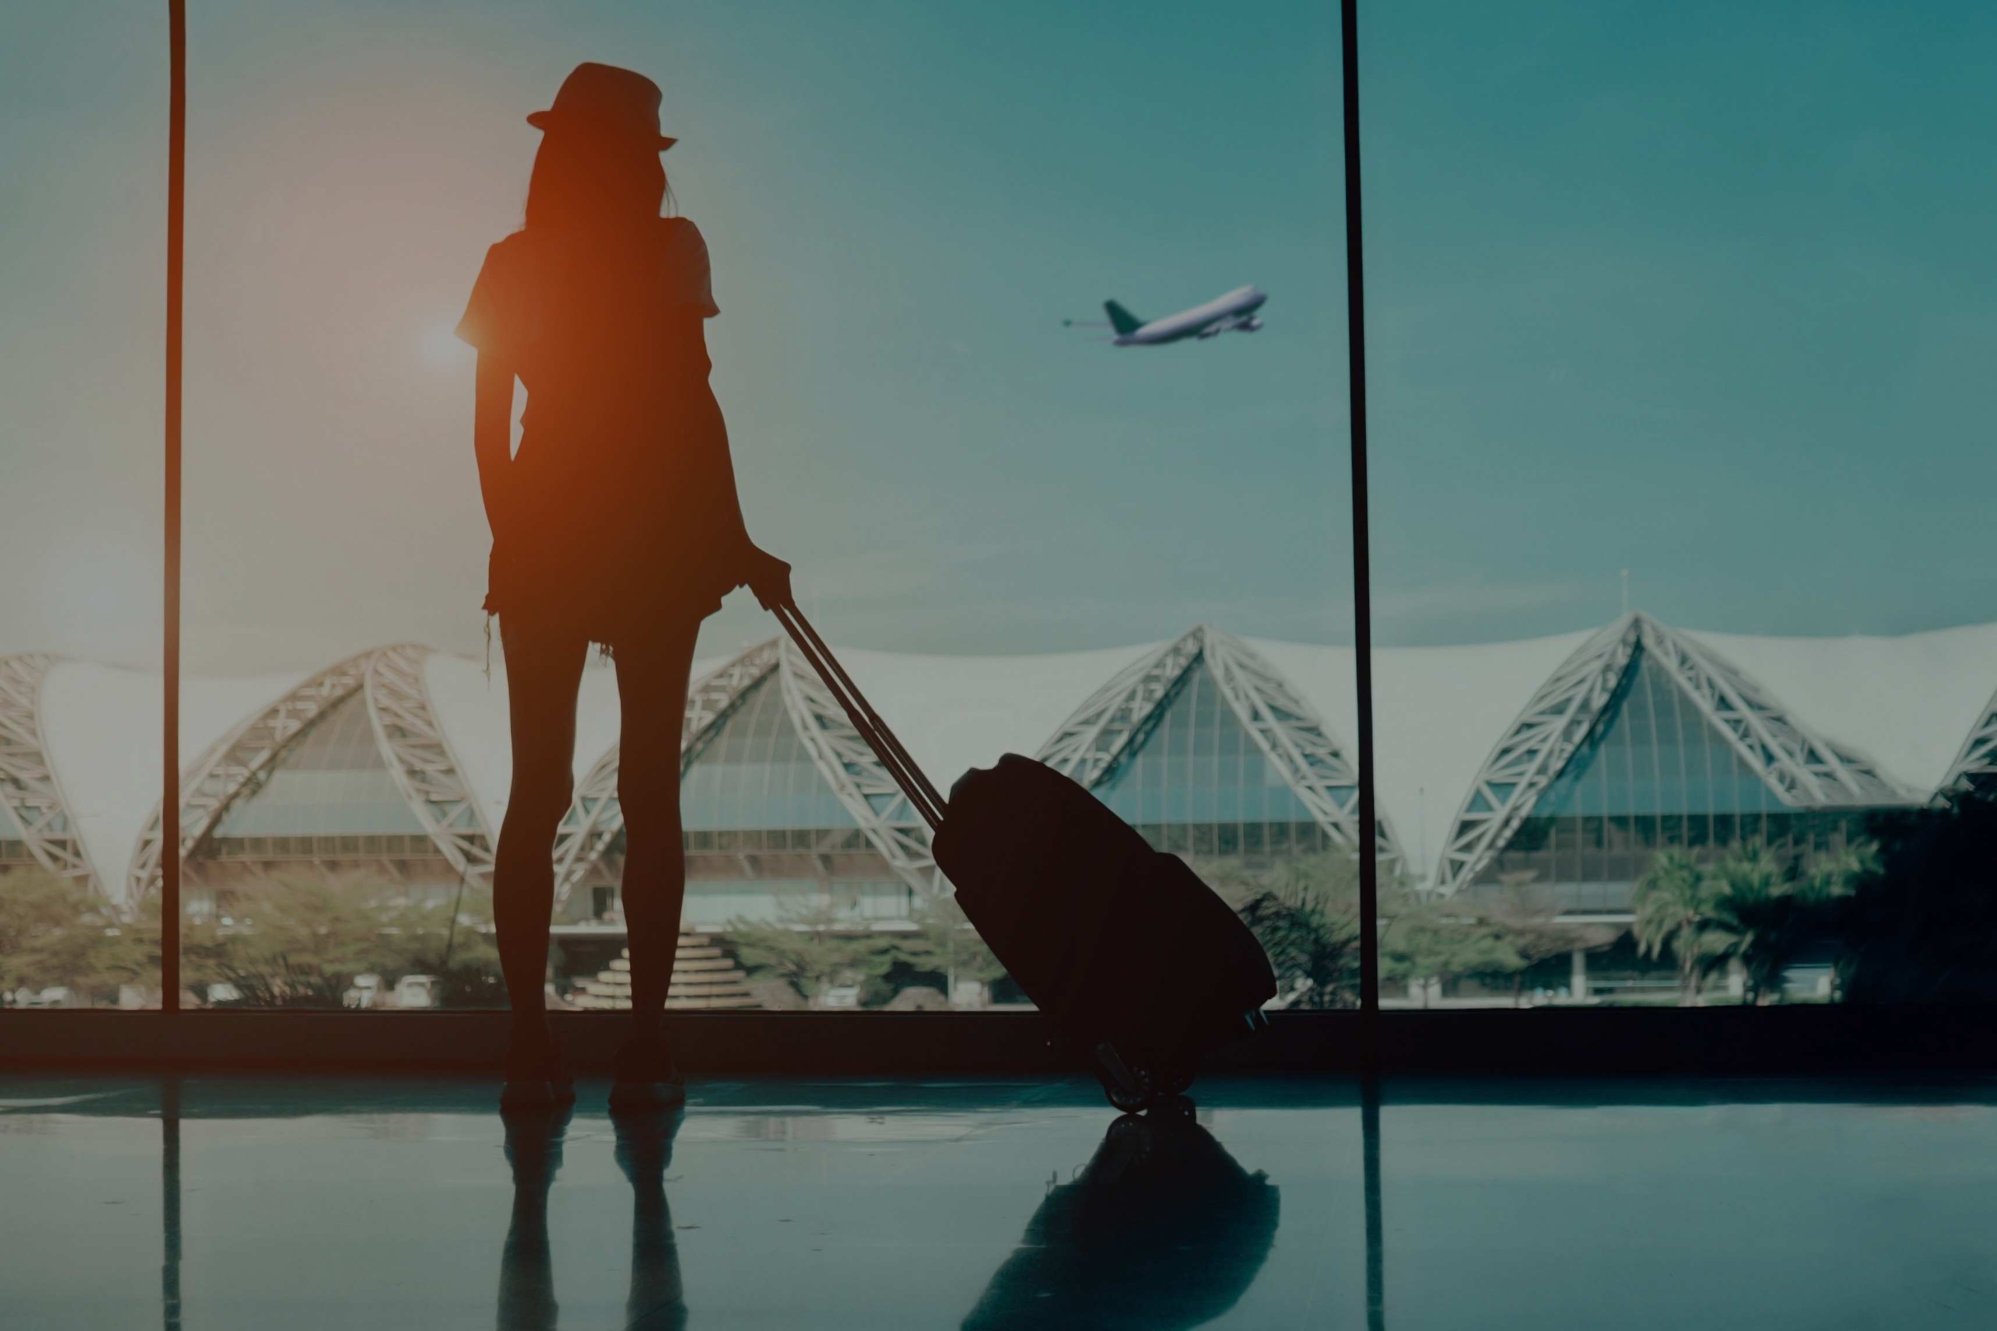




8
Go to trips
Find out about us
Read the reviews
Go to Create your own package
Choose particular trips
Plan trip from America Continent
Choose cities
Add personal information
Use Cases

Slide 10
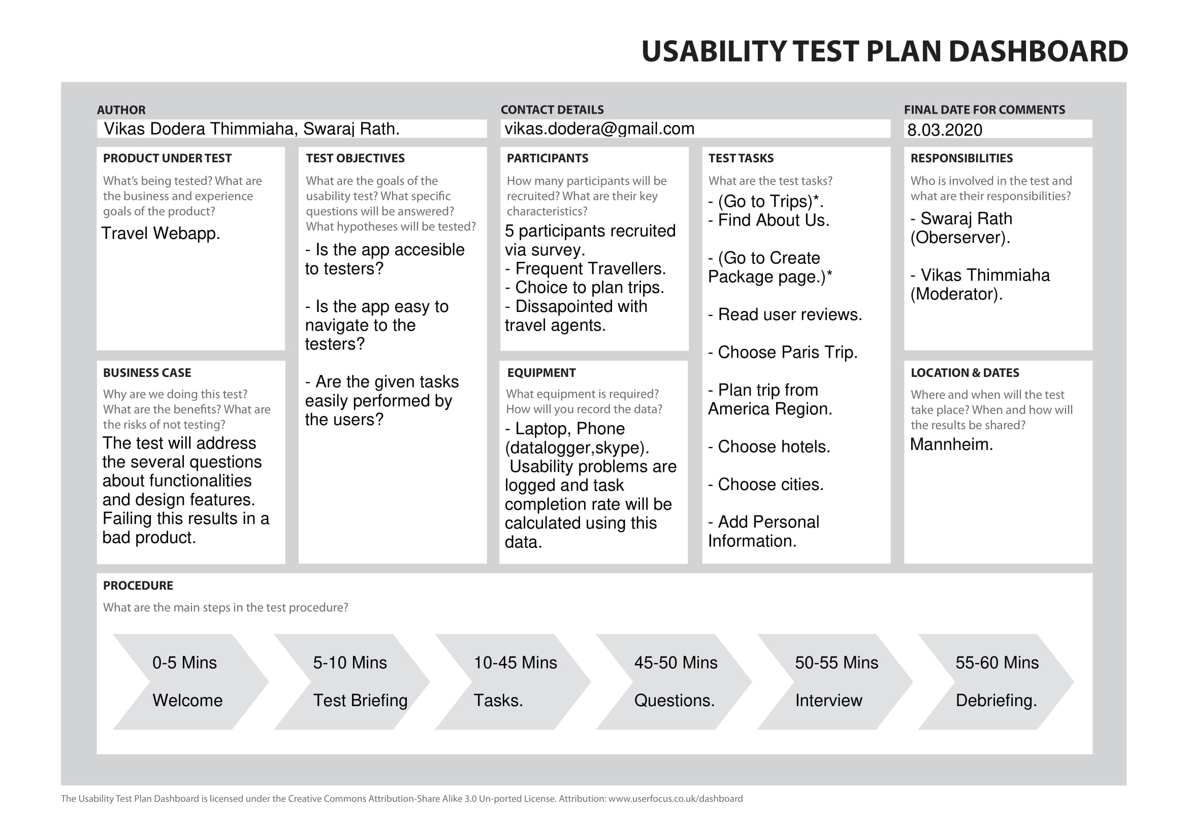
9

Slide 11
10
Think Aloud Testing Method
Recruited participants to gather information for product functionality
Participants performed specific tasks and were asked to give feedback

Slide 12



3 STEP RESULT ANALYSIS
11
Effectiveness
Efficiency
Satisfaction

Slide 13
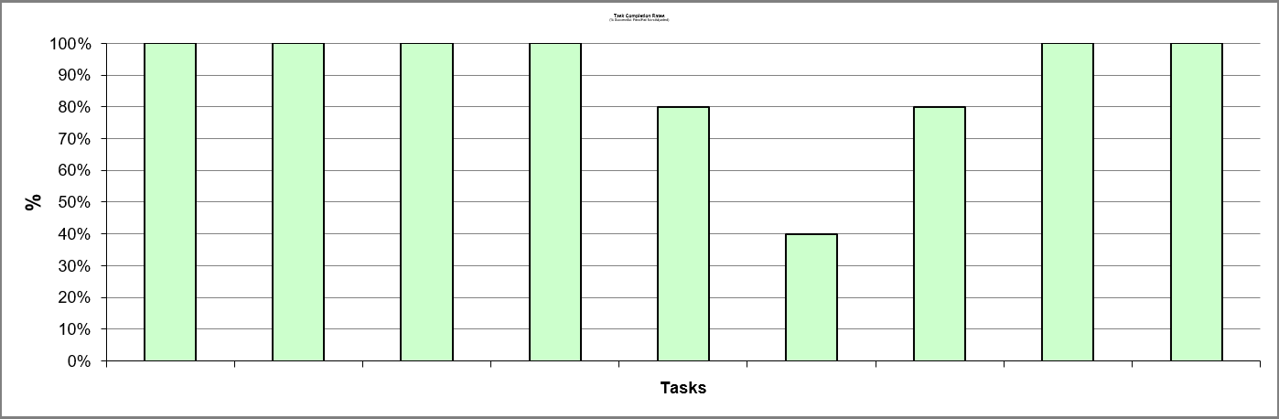
12
Task Completion

Slide 14
13
Binomial Confidence Interval
User | Input Table |  | Results Table
 | Passed Tests | Total Tests | Confidence Intervals
 |  |  | Low | High | Marginal error | Best Estimate | Percentage Low | Percentage High
Abhiskek | 9 | 9 | 0.7307 | 1 | 0.1537 | 0.9091 | 73 | 100
Grim | 7 | 9 | 0.4428 | 0.9466 | 0.2519 | 0.7273 | 44 | 95
Shruthi | 9 | 9 | 0.7307 | 1 | 0.1537 | 0.9091 | 73 | 100
Varun | 7 | 9 | 0.4428 | 0.9466 | 0.2519 | 0.7273 | 44 | 95
Pooja | 8 | 9 | 0.5433 | 0.9999 | 0.2293 | 0.8182 | 54 | 99

Slide 15
14
Efficiency Measure
USERS | TASKS
 | Abhishek | 14 | 24 | 29 | 11 | 26 | 29 | 33 | 23 | 18
 | Grim | 12 | 16 | 14 | 23 | 29 | 34 | 20 | 17 | 16
 | Shruthi | 9 | 11 | 8 | 15 | 6 | 14 | 13 | 11 | 9
 | Varun | 14 | 8 | 9 | 20 | 8 | 32 | 25 | 12 | 19
 | Pooja | 12 | 8 | 8 | 14 | 17 | 31 | 19 | 12 | 11
 | Average | 12.2 | 13.4 | 13.6 | 16.6 | 17.2 | 28 | 22 | 15 | 14.6
 | SD | 1.673 | 5.525 | 7.316 | 3.941 | 8.434 | 6.557 | 6.110 | 4.123 | 3.587
 | Max | 15.479 | 24.229 | 27.939 | 24.324 | 33.73 | 40.851 | 33.975 | 23.081 | 21.63
 | Min | 8.921 | 2.571 | 0.739 | 8.876 | 0.67 | 15.149 | 10.025 | 6.919 | 7.57

Slide 16
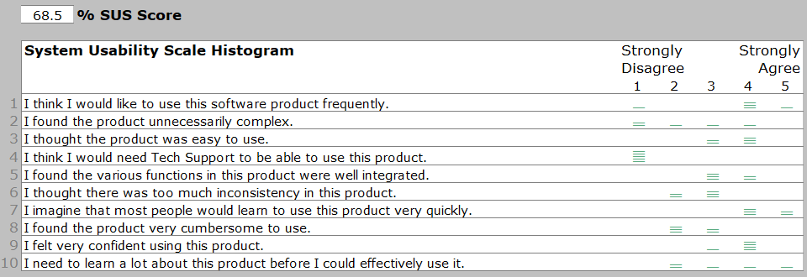
15
Satisfaction

Slide 17
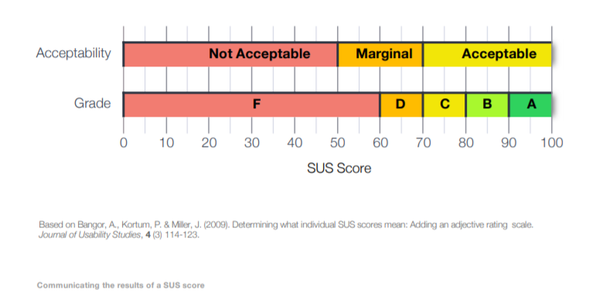
16
SUS Score

Slide 18
17
Tester’s Word List
USERS | WORDS
 | Abhishek | Exciting | Immersive | Simplistic | Obscure | Motivating | New
 | Grim | Relevant | Misleading | Useful | Reiiable | Fun | Energetic
 | Shruthi | Fun | Exciting | New | Misleading | Motivating | Useful
 | Varun | Immersive | Unpredictable | Illogical | Relevant | Useful | Exciting
 | Pooja | Useful | Simplistic | Fun | Energetic | Attractive | Exciting

Slide 19
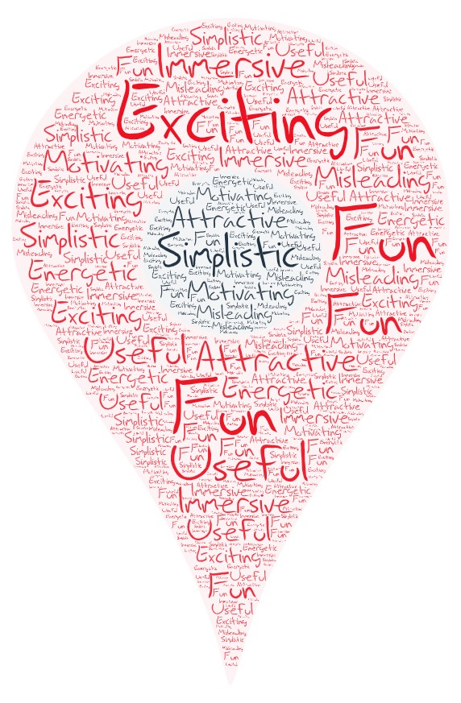
18

Slide 20
19
Conclusion
END OF OUR JOURNEY ?

